Slide 1

Predicting Customer Churn in Banking Using Machine Learning: A Comparative Analysis of Logistic Regression and Random Forest Models

Slide 2

Introduction
•Customer churn impacts profitability, and reducing churn by 5% can increase profits by 25%-95%.
•The project aims to build a predictive model for customer churn using machine learning.
•Logistic Regression and Random Forest are chosen for their interpretability and predictive power.
•The goal is to improve retention strategies by identifying at-risk customers.

Slide 3
Literature Review: Introduction to Customer Churn
•Churn is when customers leave a bank, leading to high acquisition costs.
•Effective churn analysis is vital for loyalty and retention.
•Machine learning techniques like logistic regression and decision trees are widely used in churn prediction.
•Studies from 2020-2024 focus on factors impacting customer churn in banking.

Slide 4
Literature Review: Factors Influencing Customer Turnover
•Credit Score: Lower scores correlate with a higher likelihood of churn.
•Geography: Urban customers with high competition are more prone to churn.
•Gender: Male customers are more likely to switch banks.
•Age and Tenure: Younger and newer customers have a higher churn rate.

Slide 5
Machine Learning Models in Predicting Churn
•Logistic Regression offers interpretability for churn predictors.
•Random Forest captures complex patterns and is suited for customer churn data.
•Each model has unique strengths complementing each other.
•Random Forest shows higher accuracy for churn prediction over Logistic Regression.

Slide 6
Methodology
•Data from Kaggle covers demographics and engagement details of bank customers.
•Data preprocessing includes cleaning, encoding, and scaling for model stability.
•Feature engineering selects key predictors using RFE and PCA techniques.
•Evaluation metrics: precision, recall, F1 score, and AUC-ROC.

Slide 7
Analysis
•EDA shows that variables like credit score, balance, and age are key churn indicators.
•Geographic and demographic variables reveal location-based patterns in churn.
•Correlation analysis highlights complex dependencies between variables.
•Churn distribution shows an 80% non-churn and 20% churn ratio.

Slide 8
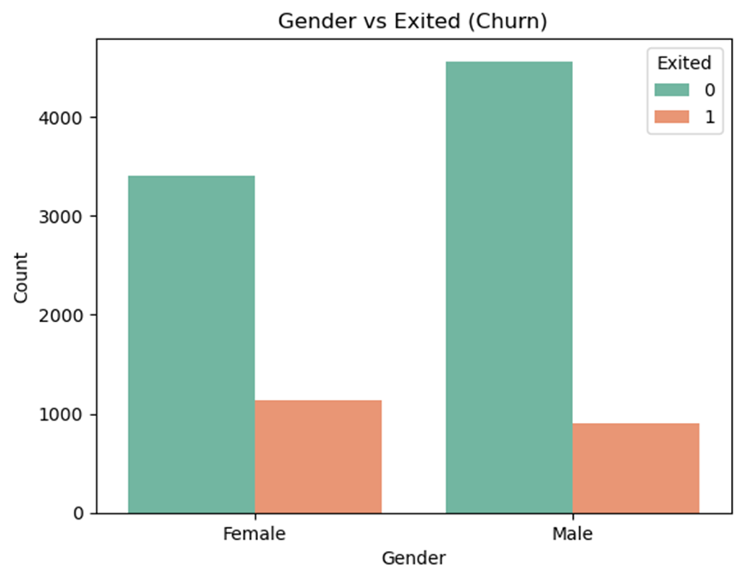
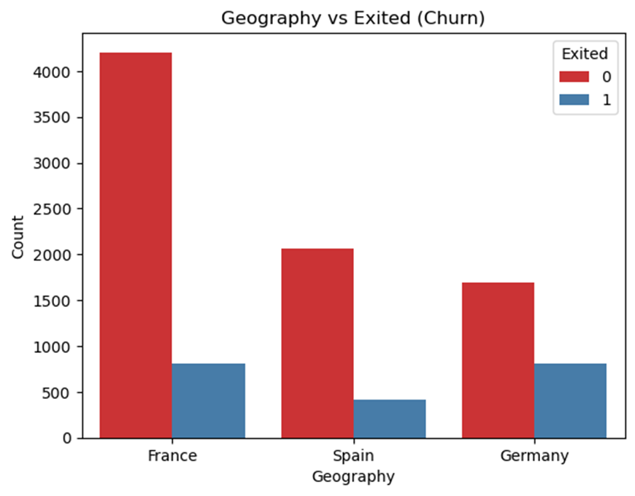
Analysis – EDA Visuals

Slide 9
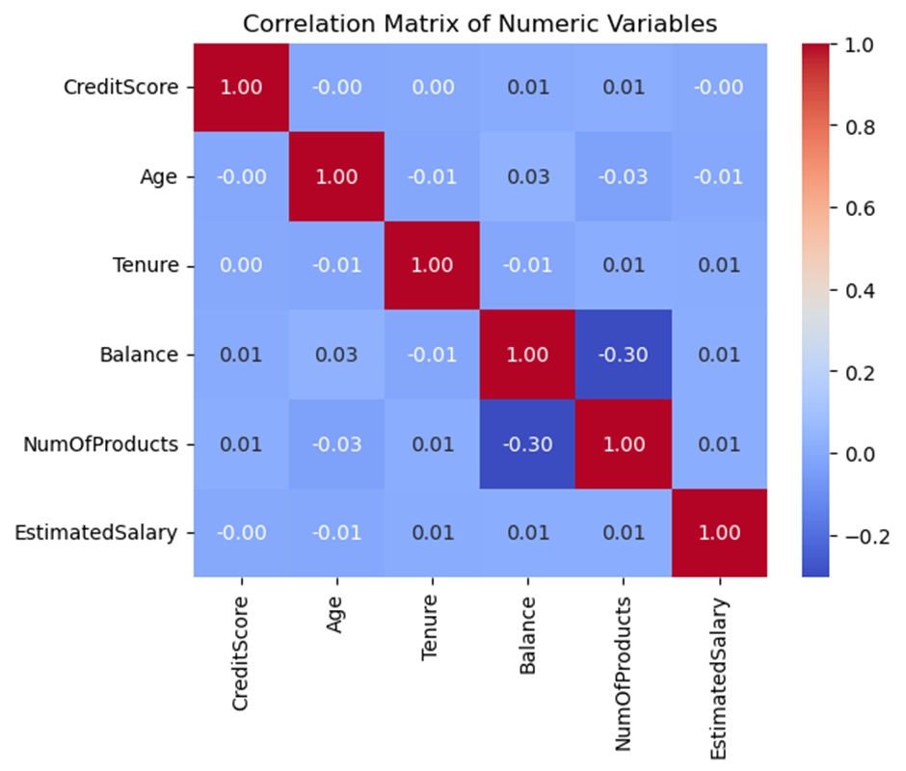
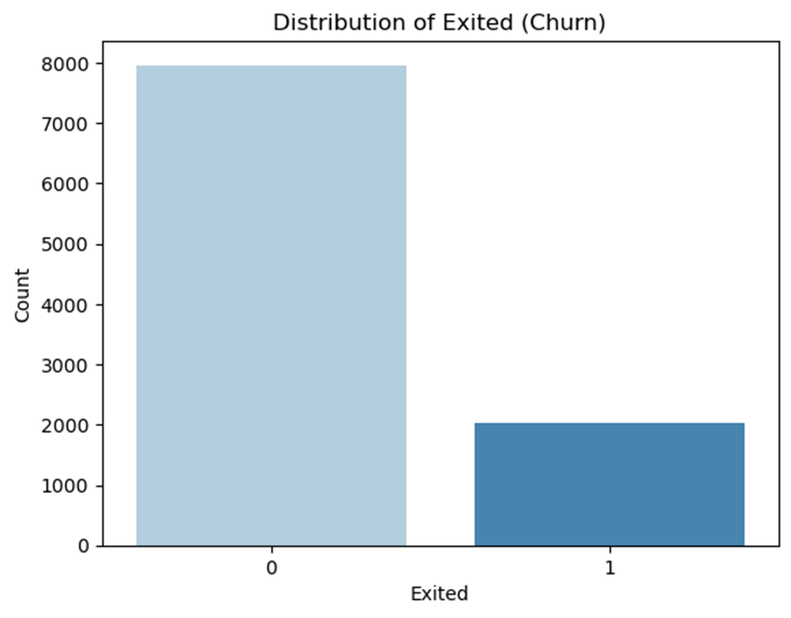
Analysis – EDA Visuals

Slide 10
Models: Logistic Regression
Achieved an accuracy of 81%, showing a fair fit for binary prediction.
Coefficients:
Age: 0.0696, indicating older customers are more likely to churn.
Balance: 5.243e-06, suggesting higher balances are associated with increased churn.
IsActiveMember: -1.0124, showing that active members are less likely to churn.
CreditScore: -0.0009, slightly reducing churn likelihood with higher scores.
Gender and credit card ownership have minimal impact on churn in this model.
AUC score of 0.77 suggests moderate discriminatory power.

Slide 11
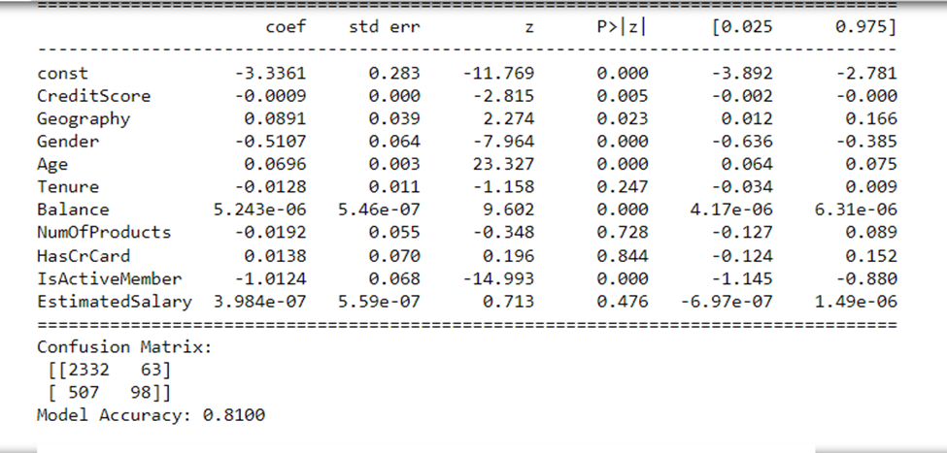
Logistic Regression

Slide 12
Models: Random Forest
•Achieved higher accuracy at 86.6%, outperforming Logistic Regression.
•Reduced false negatives, identifying at-risk customers more effectively.
•Handles complex, non-linear patterns in customer churn data.
•Provides insights into important predictors for churn.

Slide 13
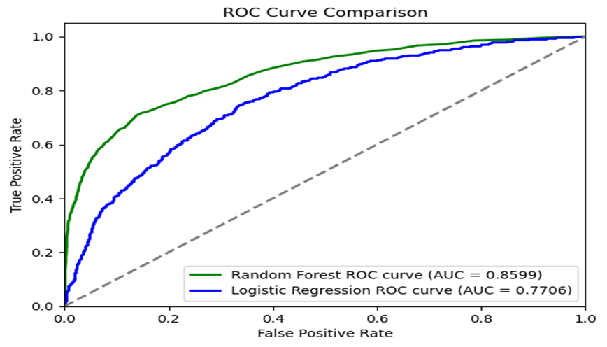
AUC Curve Comparison

Slide 14
Limitations
•Data Limitations: Sampling biases and incomplete data may skew results.
•Model Limitations: Logistic regression may oversimplify relationships.
•Random Forest can be computationally intensive on large datasets.
•Future models should focus on scalability and interpretability.

Slide 15
Conclusions and Discussions
•The study confirms machine learning's role in predicting customer churn.
•Random Forest proved more accurate for complex datasets.
•Strategies like engaging older customers can reduce churn rates.
•Machine learning can proactively manage churn and enhance customer retention.

